Slide 1
09-23
How do you solve F=ma when F is weird?

Slide 3
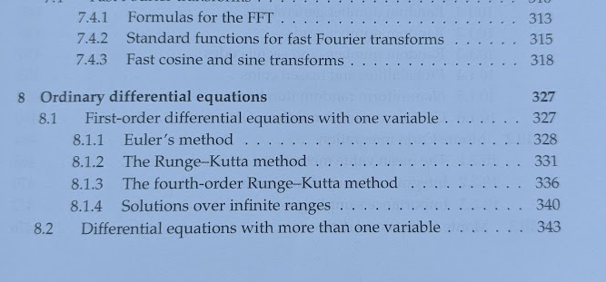


Slide 4
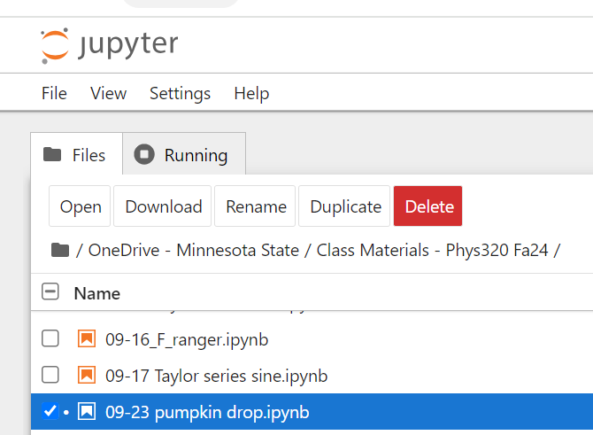
Example code

Slide 5
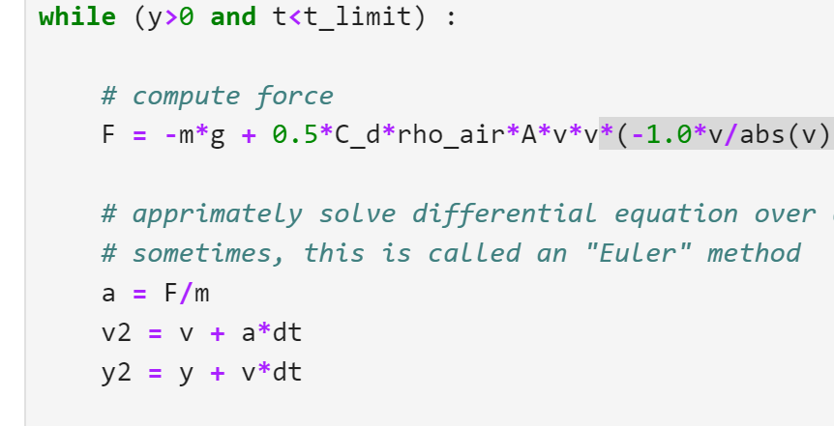




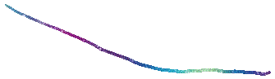

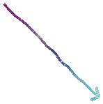



Slide 6
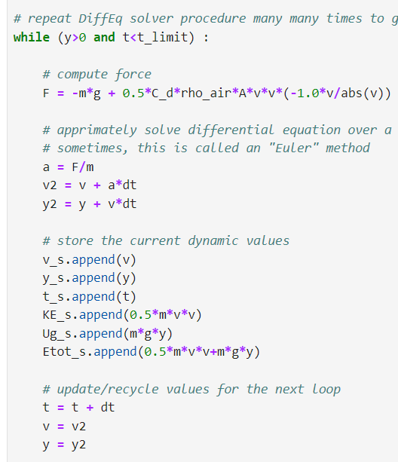

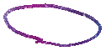



Slide 7
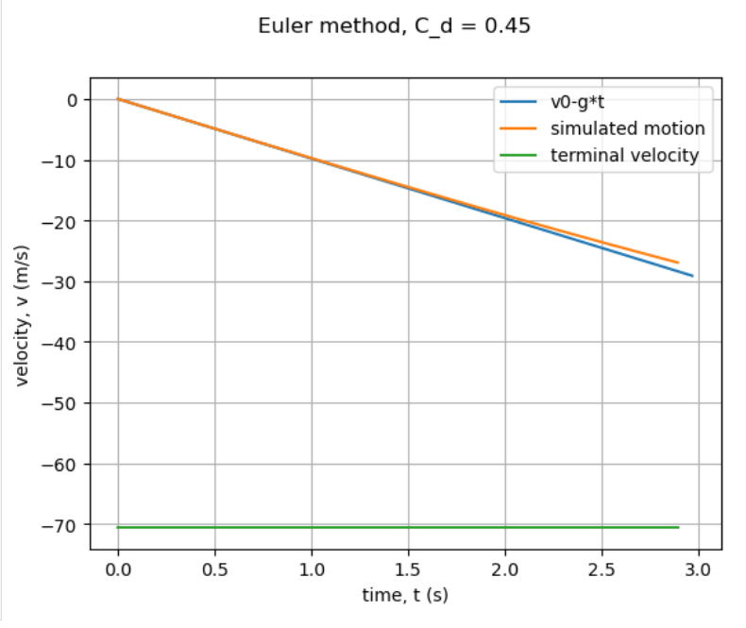
Is this right?

Slide 8
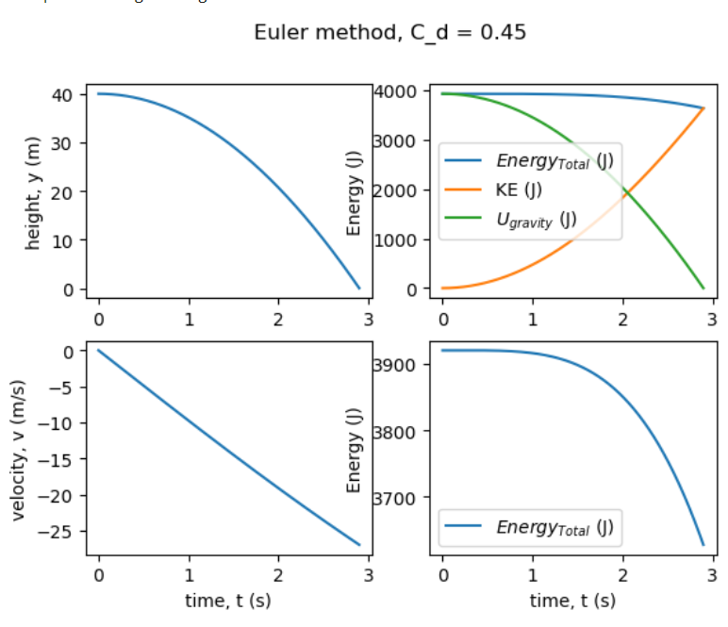
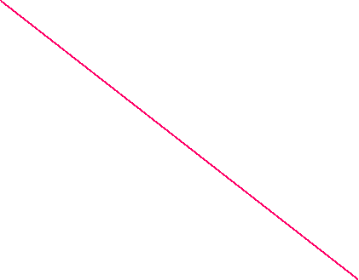
Is this right? How much system energy should be lost when there’s air resistance?????

Slide 9
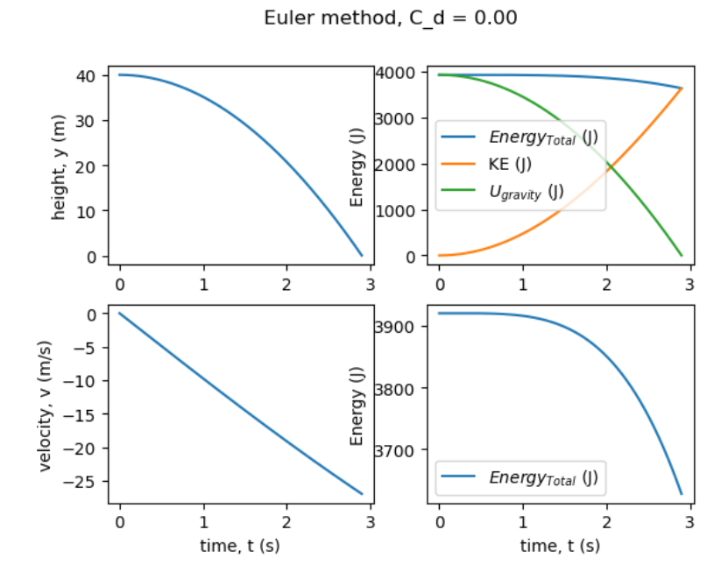
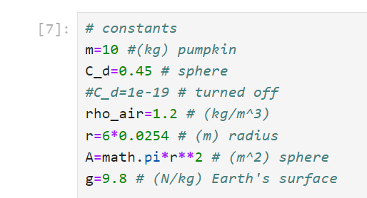
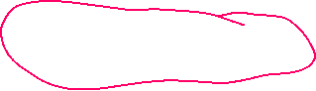

Is this right?

Slide 10
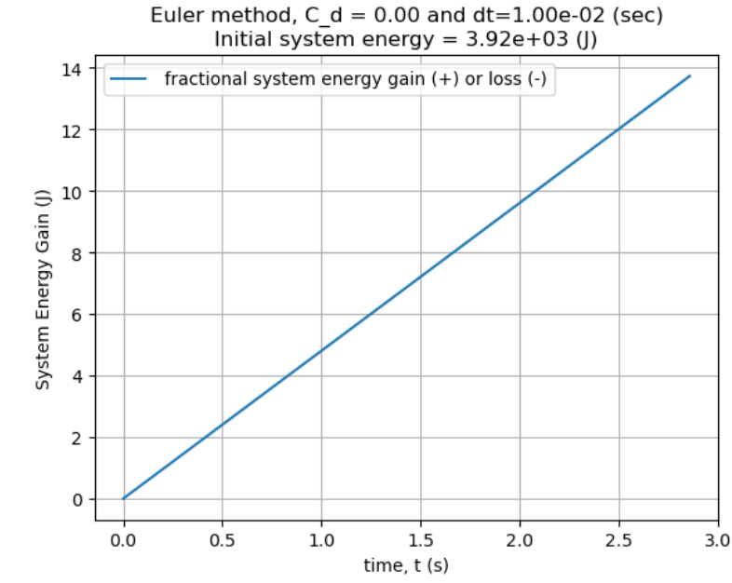

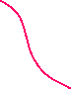

Slide 11
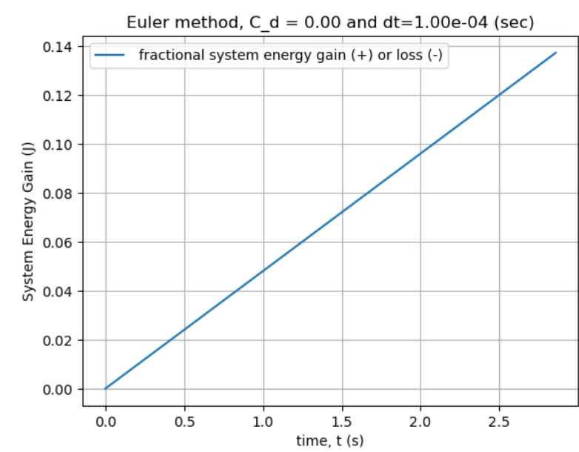
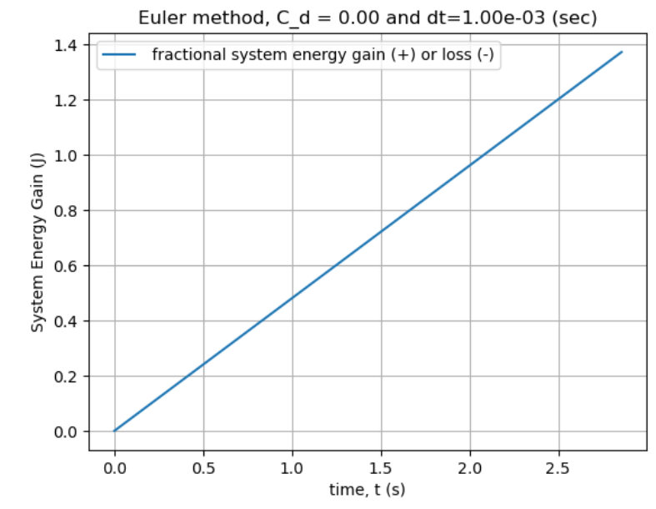



Slide 12
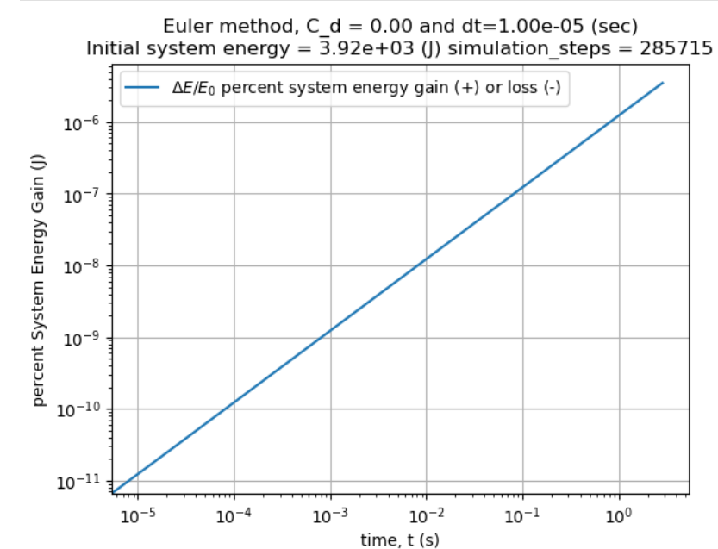

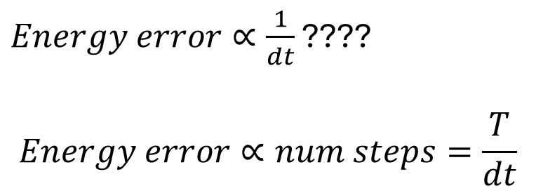

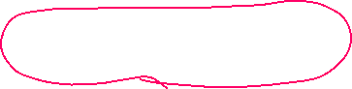
dt (s) | dE at the ground (J) | Number of simulation steps
1E-2 | 14J | 287
1E-3 | 1.4J | 2 858
1E-4 | 0.14J | 28 572
1E-5 | 0.014J | 285 715
$Energy error∝\frac{1}{dt}$ ????
$$Energy error∝num steps=\frac{T}{dt}$$

Slide 13
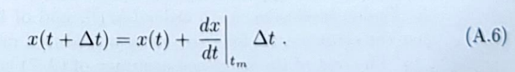
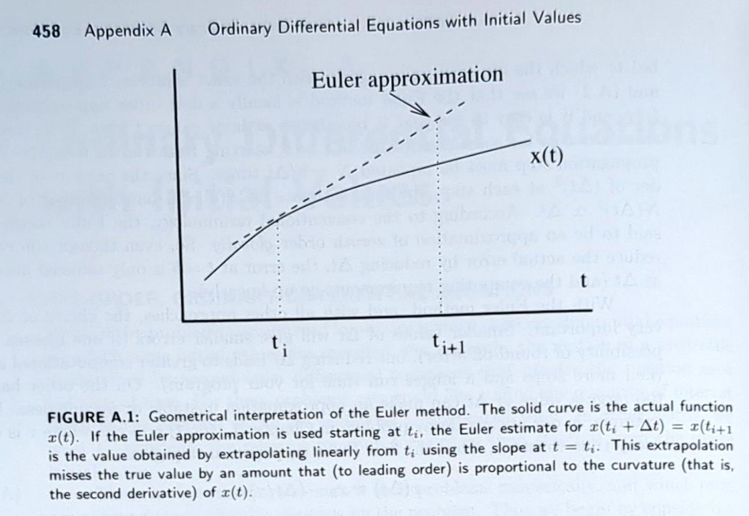



So, how do we solve F=ma more accurately?
Make dt smaller > burn more cpu cycles???
Decide error doesn’t matter?
Or, do some thinking!

Slide 14
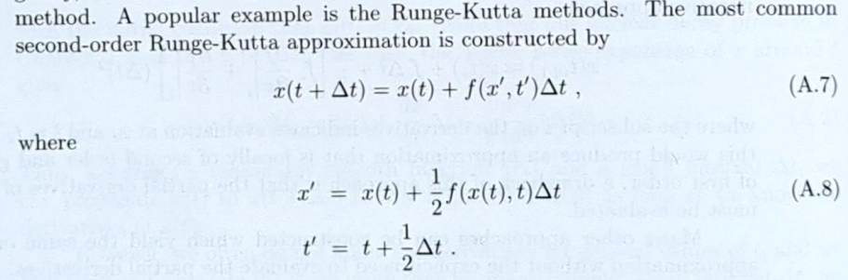
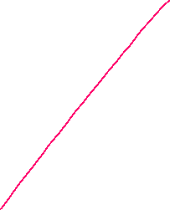
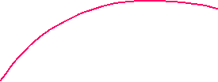
Runge-Kutta Integrator (RK2) – Draw a picture?

Slide 15
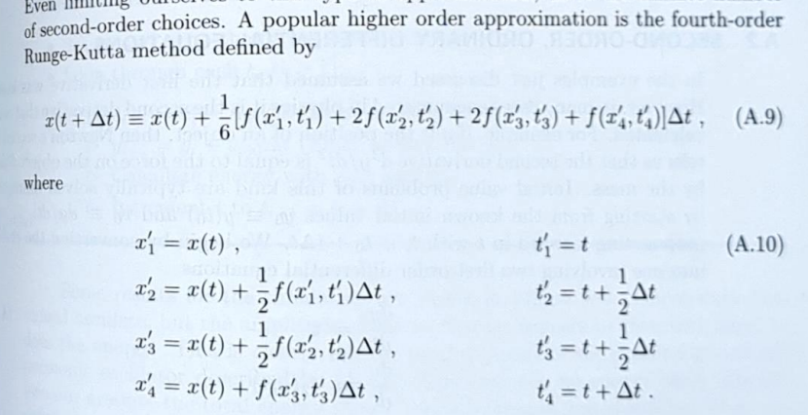


Runge-Kutta 4 Integrator (very standard method inside of eg Mathematica)

Slide 16
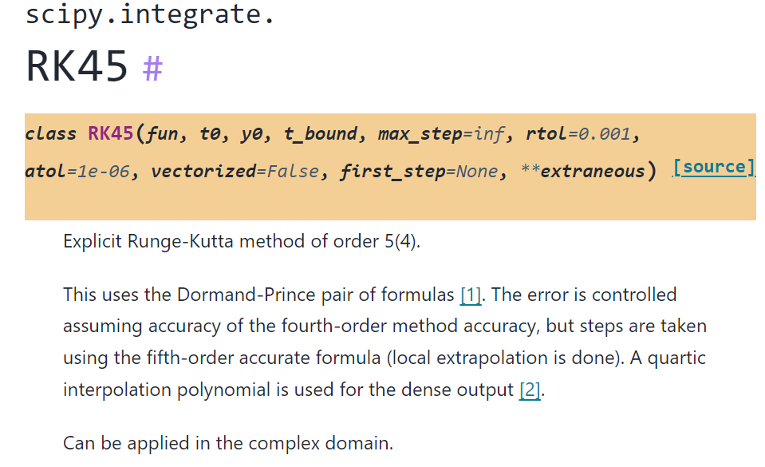

SciPy implementation https://docs.scipy.org/doc/scipy/reference/generated/scipy.integrate.RK45.html#scipy.integrate.RK45

Slide 17
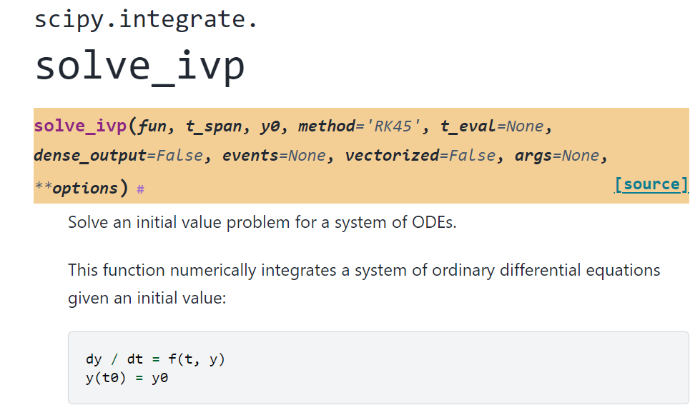

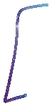
Generalized solver: https://docs.scipy.org/doc/scipy/reference/generated/scipy.integrate.solve_ivp.html#scipy.integrate.solve_ivp

Slide 18
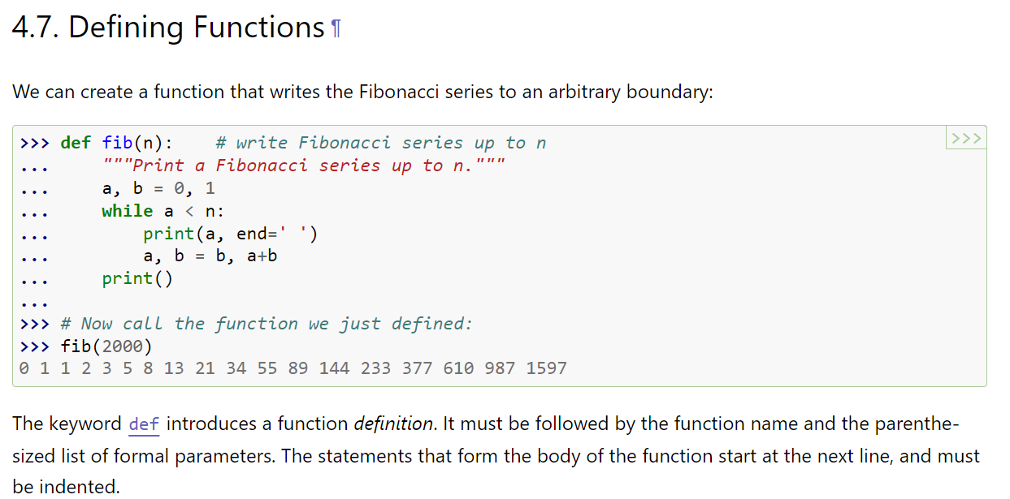
Wait? How do you define a function? https://docs.python.org/3/tutorial/controlflow.html#defining-functions

Slide 19
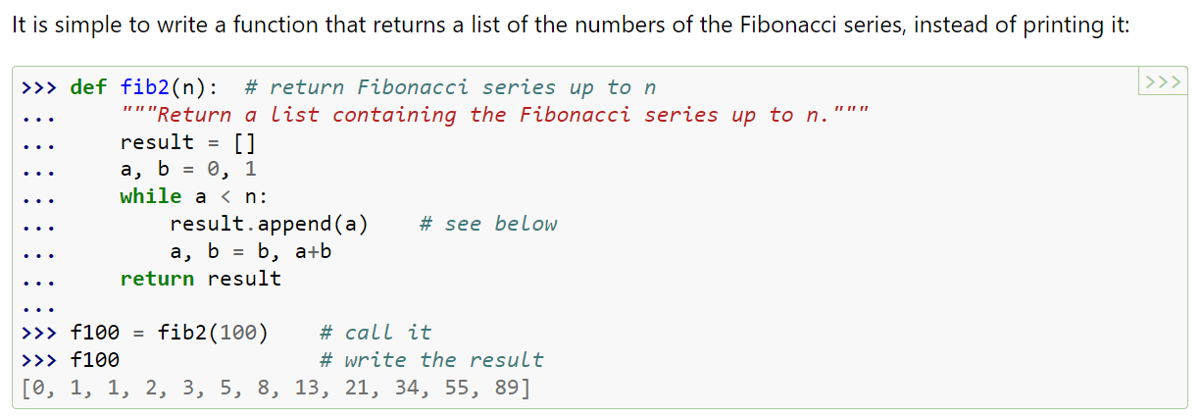

Define a function that implements $\frac{dy}{dt}$ ???

Slide 21
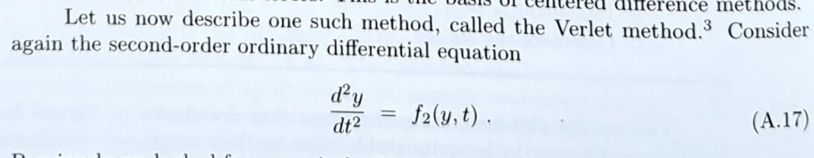
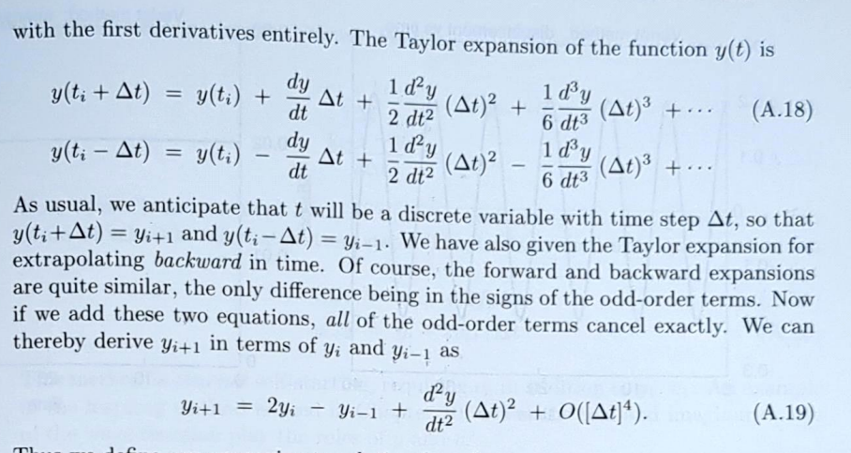




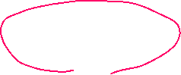
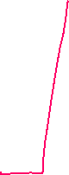








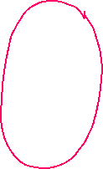


Verlet Integrator

Slide 22
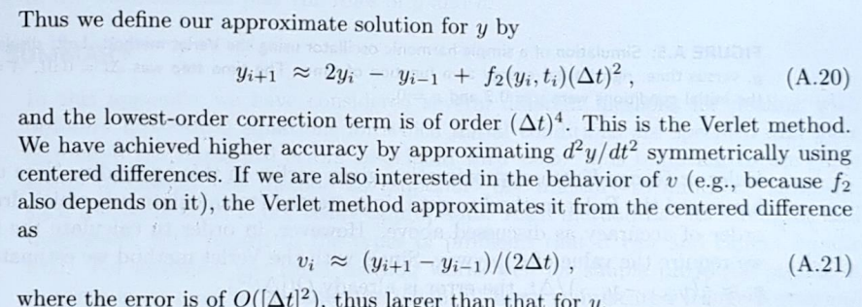
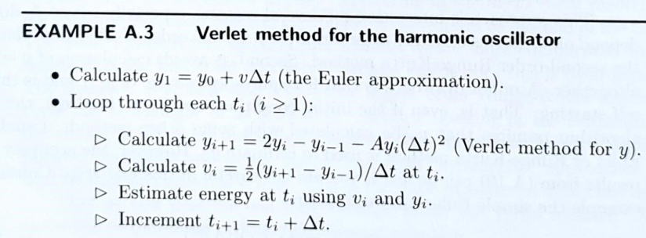




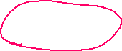
Velocity-Verlet integrator
Note, this won’t work (easily?) if Force depends on velocity - so don’t use verlet on the pumpkin drop!
Recursive defn between A.20 and A.21
See

Slide 23
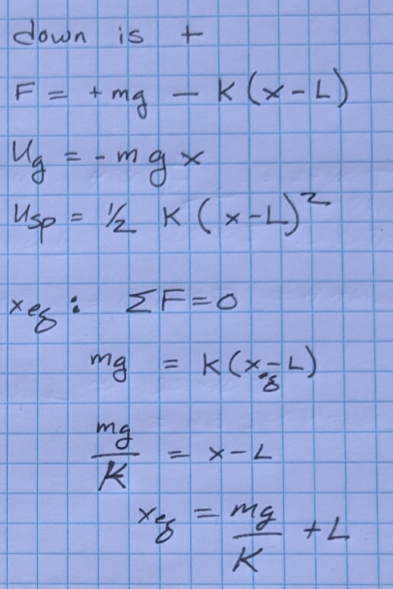
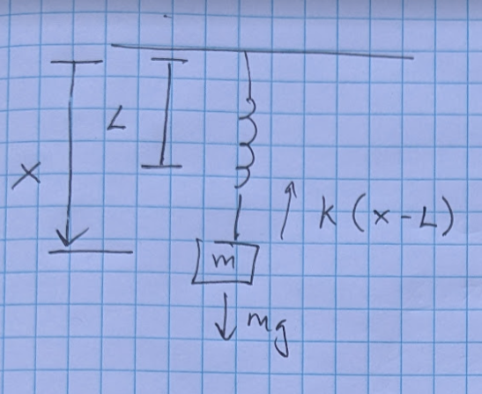


Verlet example, mass-spring

Slide 24
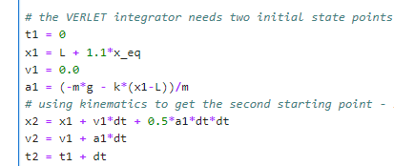
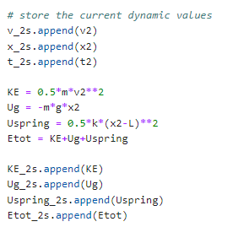
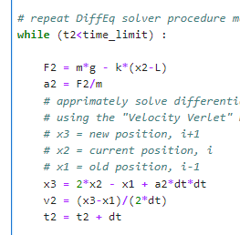
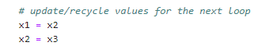
Verlet example, mass-spring

Slide 25
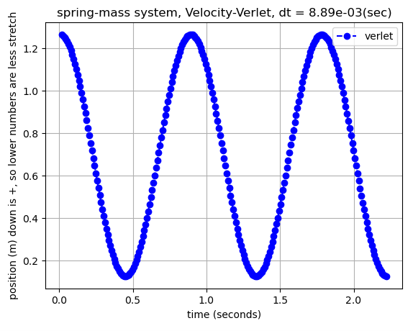
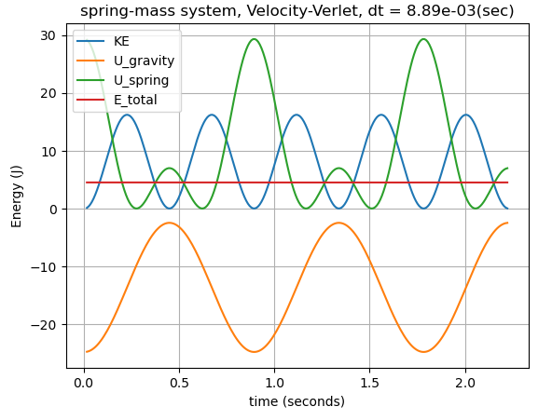
Verlet mass-spring output

Slide 26
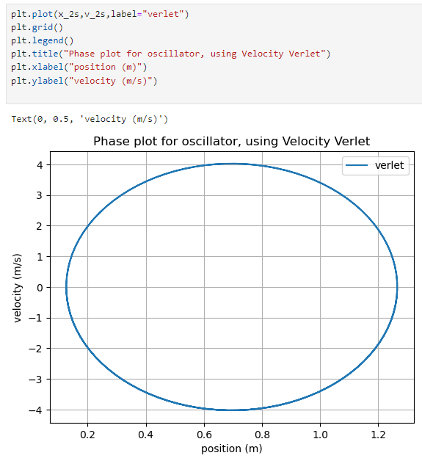
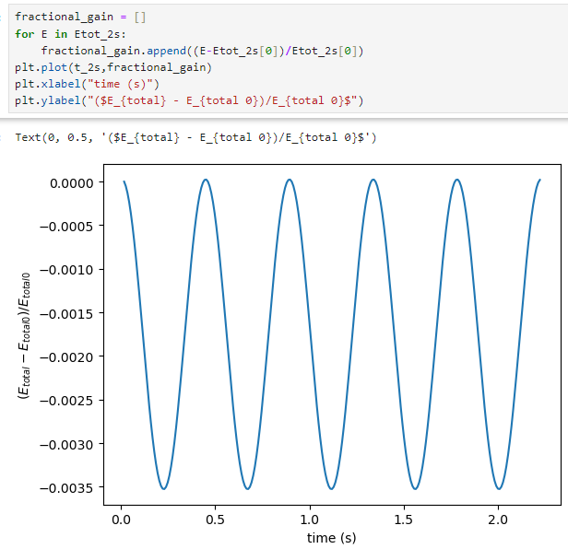
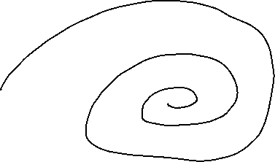
Verlet mass-spring output

Slide 27




Q: What if the DEQ is $m⋅\frac{d^{2}y}{dt^{2}}=m g −Cv^{2}$ Q: How do you solve a 2nd order ${\left(\frac{d}{dt}\right)}^{2}$DEQ?
A: Recognize this is two differential equations.
$$\frac{dy}{dt}=v$$
$$\frac{dv}{dt}=mg −C v^{2}$$
solve_ivp can solve a bunch of DEQ equations at once!

Slide 28

Example: a swing set
$$∑τ=I α$$
$$mg L sin θ=m L^{2}\frac{d^{2}θ}{dt^{2}}$$
$$mg L sin θ=m L^{2 }\frac{dω}{dt}$$
$$\frac{dθ}{dt}=ω$$

Slide 29


Example: The Northern Lights
$$∑F=m a$$
$$q v×B=m\frac{dv}{dt}$$
$$\frac{dx}{dt}=v$$
But the problem is 3D, so
$$\frac{dx}{dt}=vx$$
$$\frac{dy}{dt}=vy$$
$$\frac{dz}{dt}=vz$$
Reminder, the magnetic force law is a perpendicular force creator via a cross product.
$\hat{x}×\hat{y}=\hat{z}$
So, the other half of the differential equations look like:
$$m\frac{d vx}{dt}=q\left(vy⋅Bz−vz⋅By\right)$$
$$m\frac{d vy}{dt}=q(vz⋅Bx−vx⋅Bz)$$
$$m\frac{d vz}{dt}=q(vx⋅By−vy⋅Bx)$$

